Slide 1








SHOP 24/7
ONE STOP SOLUTION FOR ALL YOUR MOBILE NEEDS

Slide 2



MEET OUR TEAM
Name : Kirtirajsinh Parmar
Enrollment No. : 22002171310045
Roll No. : 134 Branch : CST Batch : C5
Name : Mahi Bhingradiya
Enrollment No. : 22002171310009
Roll No. : 140 Branch : CST Batch : C5
Name : Jay Badgujar
Enrollment No. : 22002170210002
Roll No. : 144 Branch : IT Batch : C5
Name : Niv Shah
Enrollment No. : 22002170210109
Roll No. : 149 Branch : IT Batch : C5
Name : Het Soni
Enrollment No. : 22002170210116
Roll No. : 157 Branch : IT Batch : C5

Slide 3
CONTENT LIST
PRESENTATION
CONTENT PRESENTATION
Presentations are communication tools that can be used as demonstrations.
01.
02.
INTRODUCTION
FUNCTIONALITIES
03.
ADVANTAGES
04.
DISADVANTAGES
05.
FUTURE SCOPES

Slide 4


INTRODUCTION
Introducing Mobile Shopping App 24/7 – your round-the-clock shopping companion. With our app, you can shop anytime, anywhere, for any mobile you need. Enjoy a seamless browsing experience, personalized recommendations, and secure transactions, all at your fingertips. Say goodbye to store hours and hello to convenience – download Mobile Shopping App 24/7 now and shop whenever inspiration strikes.

Slide 5


FUNCTIONALITIES
DEALER’S SIDE :
USER’S SIDE :
Add/Remove Phone
Buy a Phone
Add/Remove Today’s Deals
Watch Today’s Deals Section
Update Mobile’s Price/Stock
Comparison between Mobiles
Check Mobile’s Price/Stock
Give Ratings
View Sales of all Companies
Consulting to Buy a Phone

Slide 6

ADVANTAGES OF SHOP 24/7
Convinience of Use
Personalisations
Feedback and Reviews Section
Ease of Use
Analytics and Insights of Sales

Slide 7
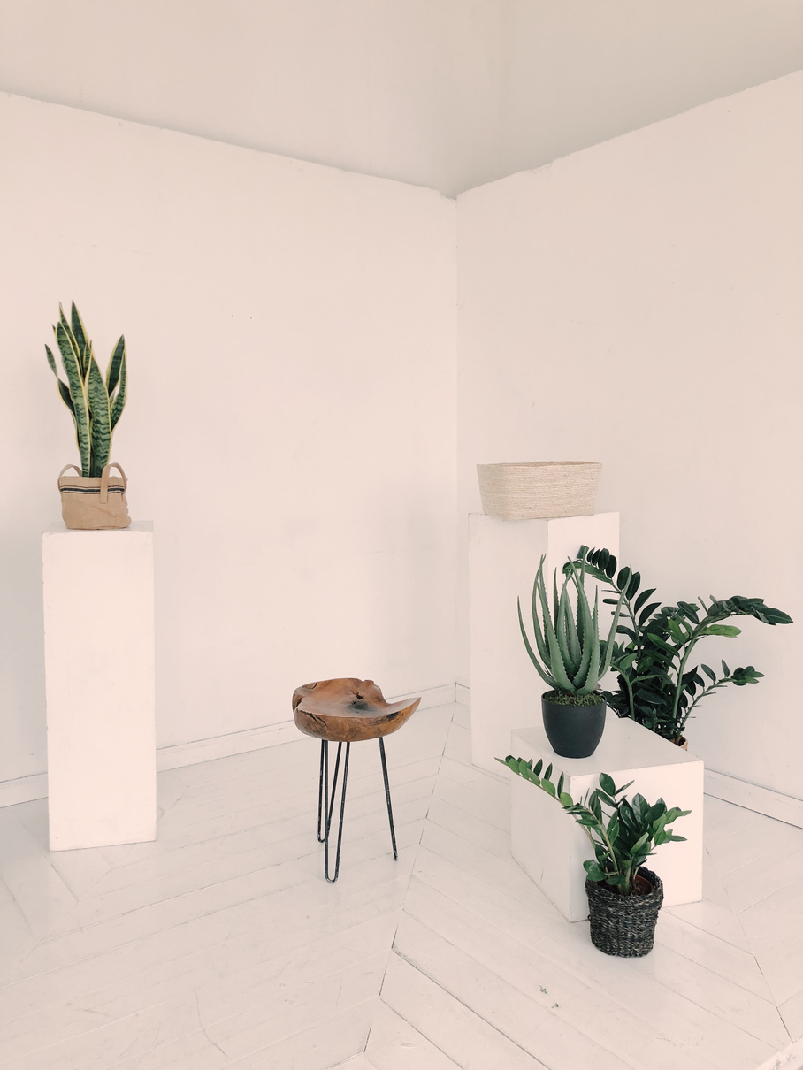
DISADVANTAGES OF SHOP 24/7
Security Concerns
Impulse Buying
No Physical View of Product
Customer Services
Lack of Personalised Assistance

Slide 8
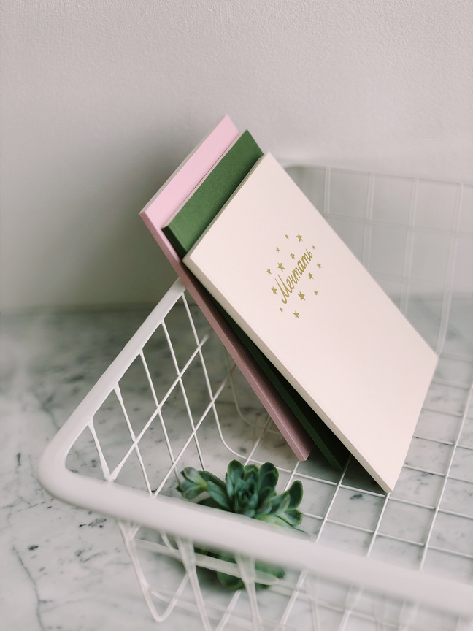


FUTURE SCOPES OF SHOP 24/7
Push Notifications
Voice Commerce Integration
Interactive and Immersive Features
Enhanced Personalisation
Social Commerce Intgration

Slide 9
THANKS FOR WATCHING AND LISTENING US
WE ALL HOPE YOU ENJOYED IT.
THANK YOU FOR GIVING YOUR PRECIOUS TIME.

